Slide 1
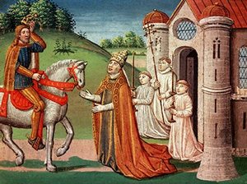
Feudalism The Middle Ages
By the ninth century, the rulers that filled the void after the fall of the Roman emperors in Western Europe were often incapable of controlling all of their lands. In exchange for loyalty, a king often granted an estate, called a fief, to a noble. The nobles constructed large estates on their fiefs called manors. This system of loyalties and
protections is known as
Feudalism, a term
derived from the fiefs.

Slide 2
Feudalism The Middle Ages
By the ninth century, the rulers that filled the void after the fall of the Roman emperors in Western Europe were often incapable of controlling all of their lands. In exchange for loyalty, a king often granted an estate, called a fief, to a noble. The nobles constructed large estates on their fiefs called manors. This system of loyalties and
protections is known as
Feudalism, a term
derived from the fiefs.

Slide 3
Feudalism The Middle Ages
By the ninth century, the rulers that filled the void after the fall of the Roman emperors in Western Europe were often incapable of controlling all of their lands. In exchange for loyalty, a king often granted an estate, called a fief, to a noble. The nobles constructed large estates on their fiefs called manors. This system of loyalties and
protections is known as
Feudalism, a term
derived from the fiefs.

Slide 4
Feudalism The Middle Ages
By the ninth century, the rulers that filled the void after the fall of the Roman emperors in Western Europe were often incapable of controlling all of their lands. In exchange for loyalty, a king often granted an estate, called a fief, to a noble. The nobles constructed large estates on their fiefs called manors. This system of loyalties and
protections is known as
Feudalism, a term
derived from the fiefs.

Slide 5
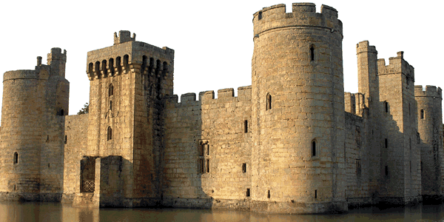
Feudalism The Middle Ages
The Lord and his family often lived in a castle, a fortified building constructed to be safe from enemy attack. These castles were unlike the images from fairy tales. They were built for protection rather than comfort. When under attack, the people of the manor retreated to the castle for protection.

Slide 6
Feudalism The Middle Ages
The Lord and his family often lived in a castle, a fortified building constructed to be safe from enemy attack. These castles were unlike the images from fairy tales. They were built for protection rather than comfort. When under attack, the people of the manor retreated to the castle for protection.

Slide 7
Feudalism The Middle Ages
The Lord and his family often lived in a castle, a fortified building constructed to be safe from enemy attack. These castles were unlike the images from fairy tales. They were built for protection rather than comfort. When under attack, the people of the manor retreated to the castle for protection.

Slide 8
Feudalism The Middle Ages
The Lord and his family often lived in a castle, a fortified building constructed to be safe from enemy attack. These castles were unlike the images from fairy tales. They were built for protection rather than comfort. When under attack, the people of the manor retreated to the castle for protection.

Slide 9
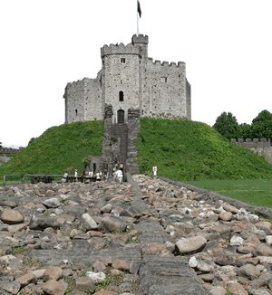
Feudalism The Middle Ages
Motte-and-bailey castles were constructed on large mounds called mottes. The earth used to build the motte formed a ditch. A drawbridge over the ditch could be retracted when an enemy approached the manor. The bailey was the area below the castle where most of work of the manor was done.

Slide 10
Feudalism The Middle Ages
Motte-and-bailey castles were constructed on large mounds called mottes. The earth used to build the motte formed a ditch. A drawbridge over the ditch could be retracted when an enemy approached the manor. The bailey was the area below the castle where most of work of the manor was done.

Slide 11
Feudalism The Middle Ages
Motte-and-bailey castles were constructed on large mounds called mottes. The earth used to build the motte formed a ditch. A drawbridge over the ditch could be retracted when an enemy approached the manor. The bailey was the area below the castle where most of work of the manor was done.

Slide 12
Feudalism The Middle Ages
Motte-and-bailey castles were constructed on large mounds called mottes. The earth used to build the motte formed a ditch. A drawbridge over the ditch could be retracted when an enemy approached the manor. The bailey was the area below the castle where most of work of the manor was done.

Slide 13
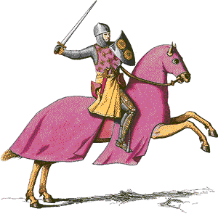
Feudalism The Middle Ages
The nobles pledged to train knights, mounted warriors who fought using swords and lances. The introduction of stirrups, supports for the rider’s feet hanging from the saddle, allowed cavalry to remain on their horses. A knight attacking
on horseback with a lance
tucked under his arm caused
tremendous damage to his
foe. The galloping horse
was also a moving target
that was difficult for an
enemy force to attack.

Slide 14
Feudalism The Middle Ages
The nobles pledged to train knights, mounted warriors who fought using swords and lances. The introduction of stirrups, supports for the rider’s feet hanging from the saddle, allowed cavalry to remain on their horses. A knight attacking
on horseback with a lance
tucked under his arm caused
tremendous damage to his
foe. The galloping horse
was also a moving target
that was difficult for an
enemy force to attack.

Slide 15
Feudalism The Middle Ages
The nobles pledged to train knights, mounted warriors who fought using swords and lances. The introduction of stirrups, supports for the rider’s feet hanging from the saddle, allowed cavalry to remain on their horses. A knight attacking
on horseback with a lance
tucked under his arm caused
tremendous damage to his
foe. The galloping horse
was also a moving target
that was difficult for an
enemy force to attack.

Slide 16
Feudalism The Middle Ages
The nobles pledged to train knights, mounted warriors who fought using swords and lances. The introduction of stirrups, supports for the rider’s feet hanging from the saddle, allowed cavalry to remain on their horses. A knight attacking
on horseback with a lance
tucked under his arm caused
tremendous damage to his
foe. The galloping horse
was also a moving target
that was difficult for an
enemy force to attack.

Slide 17
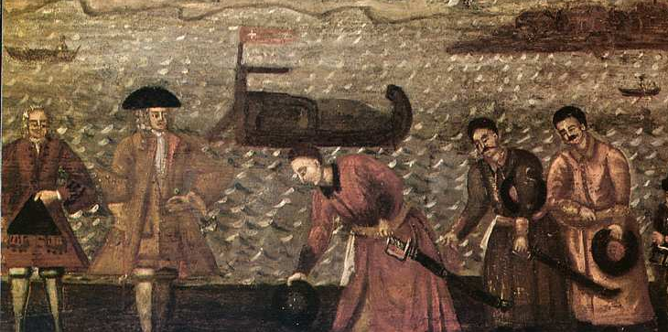
Feudalism The Middle Ages
Peasant farmers needed the noble’s protection as German, Viking, Magyar, and Moorish armies overran small houses and farms throughout Europe. Some peasants were freemen who owned or rented land from the Lord, but most were serfs.

Slide 18
Feudalism The Middle Ages
Peasant farmers needed the noble’s protection as German, Viking, Magyar, and Moorish armies overran small houses and farms throughout Europe. Some peasants were freemen who owned or rented land from the Lord, but most were serfs.

Slide 19
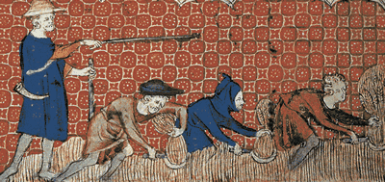
Feudalism The Middle Ages
Serfs could not be sold like slaves, but they could not leave their manor without permission from the Lord. The Lord provided the serf and his family a safe place to live and land to grow food. In exchange, serfs were required to work a particular number of days on the lord's personal fields.

Slide 20
Feudalism The Middle Ages
Serfs could not be sold like slaves, but they could not leave their manor without permission from the Lord. The Lord provided the serf and his family a safe place to live and land to grow food. In exchange, serfs were required to work a particular number of days on the lord's personal fields.

Slide 21
Feudalism The Middle Ages
Serfs could not be sold like slaves, but they could not leave their manor without permission from the Lord. The Lord provided the serf and his family a safe place to live and land to grow food. In exchange, serfs were required to work a particular number of days on the lord's personal fields.

Slide 22
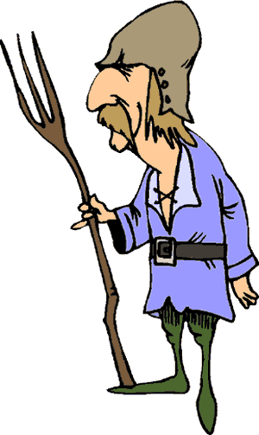
Feudalism The Middle Ages
Serfs were not allowed to marry without permission from the Lord; the family of a serf would have to turn over additional crops when someone wanted to marry and leave the manor. Serfs were encouraged to have many children because a small family might not have enough daylight hours to tend their family plot after their work in the Lord's fields was complete. Lords often forced families to pay a tax when a member of their household died to compensate for the manor's loss of labor.

Slide 23
Feudalism The Middle Ages
Serfs were not allowed to marry without permission from the Lord; the family of a serf would have to turn over additional crops when someone wanted to marry and leave the manor. Serfs were encouraged to have many children because a small family might not have enough daylight hours to tend their family plot after their work in the Lord's fields was complete. Lords often forced families to pay a tax when a member of their household died to compensate for the manor's loss of labor.

Slide 24
Feudalism The Middle Ages
Serfs were not allowed to marry without permission from the Lord; the family of a serf would have to turn over additional crops when someone wanted to marry and leave the manor. Serfs were encouraged to have many children because a small family might not have enough daylight hours to tend their family plot after their work in the Lord's fields was complete. Lords often forced families to pay a tax when a member of their household died to compensate for the manor's loss of labor.

Slide 25
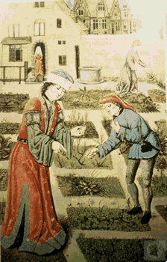
Feudalism The Middle Ages
There was very little social mobility, or chance to move upward in status during the Middle Ages. A serf who lived on the manor of a Lord was likely the descendant of a peasant who had served the ancestor of that Lord. For centuries, a person’s life was all but guaranteed to be exactly like their parents' lives.

Slide 26
Feudalism The Middle Ages
There was very little social mobility, or chance to move upward in status during the Middle Ages. A serf who lived on the manor of a Lord was likely the descendant of a peasant who had served the ancestor of that Lord. For centuries, a person’s life was all but guaranteed to be exactly like their parents' lives.

Slide 27
Feudalism The Middle Ages
There was very little social mobility, or chance to move upward in status during the Middle Ages. A serf who lived on the manor of a Lord was likely the descendant of a peasant who had served the ancestor of that Lord. For centuries, a person’s life was all but guaranteed to be exactly like their parents' lives.

Slide 28
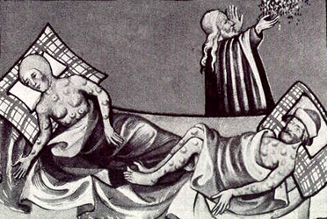
Feudalism The Middle Ages
The feudal system proved impractical by the end of the Middle Ages. A terrible disease called the Black Death claimed the lives of millions of Europeans in the fourteenth century, so in many places there were not enough peasants to farm the vast estates.

Slide 29
Feudalism The Middle Ages
The feudal system proved impractical by the end of the Middle Ages. A terrible disease called the Black Death claimed the lives of millions of Europeans in the fourteenth century, so in many places there were not enough peasants to farm the vast estates.

Slide 30
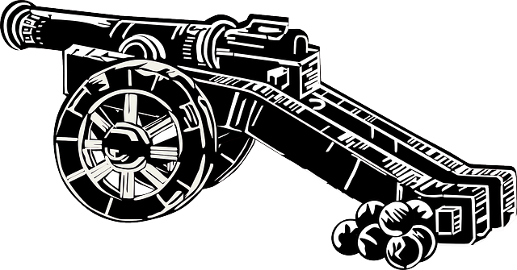
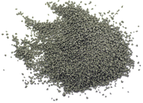
Feudalism The Middle Ages
The introduction of gunpowder and long-range cannons made knights fighting with swords on horseback an outdated form of warfare that was expensive to train and support.

Slide 31
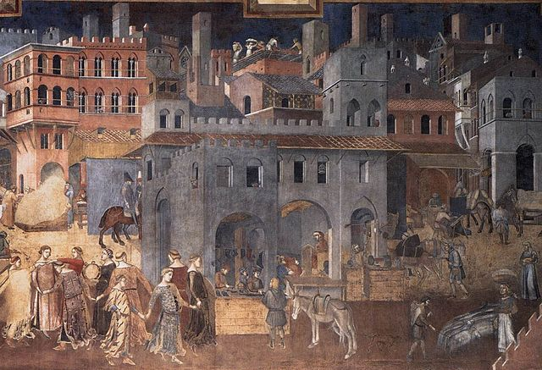
Feudalism The Middle Ages
At about the same time, cities were growing in population for the first time since the fall of the Roman Empire. These changes in society would lead to the Renaissance—the rebirth of Europe and the beginning of modern history.

Slide 32
Feudalism The Middle Ages
At about the same time, cities were growing in population for the first time since the fall of the Roman Empire. These changes in society would lead to the Renaissance—the rebirth of Europe and the beginning of modern history.

Slide 33
Feudalism The Middle Ages
Music credit:
Breakdown by Kevin MacLeod
(incompetech.com)
Licensed under Creative Commons: By Attribution 3.0
http://creativecommons.org/licenses/by/3.0/
Learn more about history at
www.mrdowling.com

