Slide 1
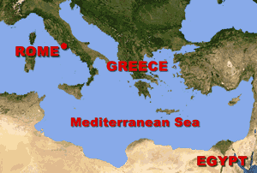
Constantine and the Fall of Rome Ancient Rome
Italy is a peninsula that extends into the Mediterranean Sea east of the Greek peninsula. Rome lies on the western shore near the center of the peninsula. Today Rome is the capital of the modern nation of Italy and one of the largest cities in Europe, but Rome was once the seat of a huge empire.

Slide 2
A New Power Rises Ancient Rome
Music credit:
“Starburst Dreams” by
Dan-O at http://danosongs.com.
Learn more about history at
www.mrdowling.com

