Slide 1
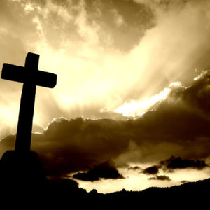
Christianity Ancient Rome
Christianity is now the religion of over two billion people on every populated continent, but the faith began as a small movement in the city of Jerusalem in the Roman province of Judea. Jerusalem is a city on the eastern coast of the Mediterranean Sea in the modern nation of Israel.

Slide 2
Christianity Ancient Rome
Christianity is now the religion of over two billion people on every populated continent, but the faith began as a small movement in the city of Jerusalem in the Roman province of Judea. Jerusalem is a city on the eastern coast of the Mediterranean Sea in the modern nation of Israel.

Slide 3
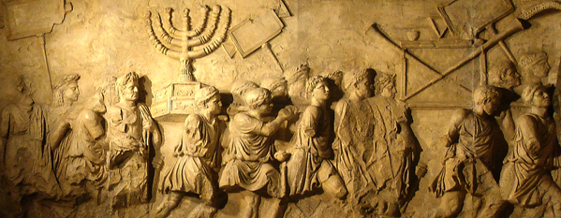
Christianity Ancient Rome
Most of the people who lived in and near Jerusalem during the reign of Caesar Augustus were Jews who believed in one God. This was unusual because at that time, most Romans were polytheists. Polytheists are people who believe in many gods.

Slide 4
Christianity Ancient Rome
Most of the people who lived in and near Jerusalem during the reign of Caesar Augustus were Jews who believed in one God. This was unusual because at that time, most Romans were polytheists. Polytheists are people who believe in many gods.

Slide 5
Christianity Ancient Rome
Most of the people who lived in and near Jerusalem during the reign of Caesar Augustus were Jews who believed in one God. This was unusual because at that time, most Romans were polytheists. Polytheists are people who believe in many gods.

Slide 6
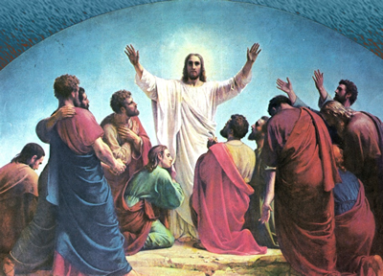
Christianity Ancient Rome
The Romans allowed the Jews to practice their faith and did not force the Jews to worship Roman gods. About AD30, a holy man named Jesus began to attract a following in Jerusalem. Jesus’ followers came to believe that Jesus was the son of the God of the Jews and that he performed miracles.

Slide 7
Christianity Ancient Rome
The Romans allowed the Jews to practice their faith and did not force the Jews to worship Roman gods. About AD30, a holy man named Jesus began to attract a following in Jerusalem. Jesus’ followers came to believe that Jesus was the son of the God of the Jews and that he performed miracles.

Slide 8
Christianity Ancient Rome
The Romans allowed the Jews to practice their faith and did not force the Jews to worship Roman gods. About AD30, a holy man named Jesus began to attract a following in Jerusalem. Jesus’ followers came to believe that Jesus was the son of the God of the Jews and that he performed miracles.

Slide 9
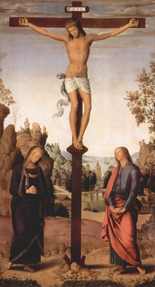
Christianity Ancient Rome
The followers of Jesus angered Roman authorities because they refused to follow either Jewish or Roman laws. The authorities arrested and executed Jesus by nailing him to a cross. This form of execution is known as crucifixion. Three days after his execution, Jesus’ followers said they saw him risen from the dead.

Slide 10
Christianity Ancient Rome
The followers of Jesus angered Roman authorities because they refused to follow either Jewish or Roman laws. The authorities arrested and executed Jesus by nailing him to a cross. This form of execution is known as crucifixion. Three days after his execution, Jesus’ followers said they saw him risen from the dead.

Slide 11
Christianity Ancient Rome
The followers of Jesus angered Roman authorities because they refused to follow either Jewish or Roman laws. The authorities arrested and executed Jesus by nailing him to a cross. This form of execution is known as crucifixion. Three days after his execution, Jesus’ followers said they saw him risen from the dead.

Slide 12
Christianity Ancient Rome
The followers of Jesus angered Roman authorities because they refused to follow either Jewish or Roman laws. The authorities arrested and executed Jesus by nailing him to a cross. This form of execution is known as crucifixion. Three days after his execution, Jesus’ followers said they saw him risen from the dead.

Slide 13
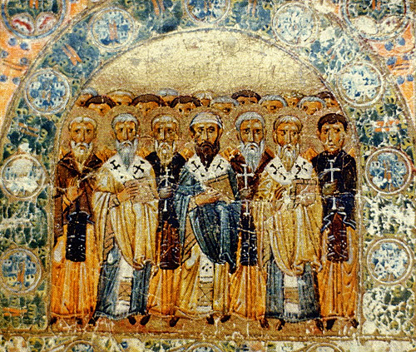
Christianity Ancient Rome
The followers of Jesus called him Christ. Christ is a Greek word that means “chosen one,” because his followers believed Jesus was chosen by God to be his messenger. In time, the followers of Jesus became known as Christians. The Christians taught that people’s sins would be forgiven if they became Christian. Their message was not successful with many Jews, but countless pagans throughout the Roman Empire responded to the idea of Christian salvation.

Slide 14
Christianity Ancient Rome
The followers of Jesus called him Christ. Christ is a Greek word that means “chosen one,” because his followers believed Jesus was chosen by God to be his messenger. In time, the followers of Jesus became known as Christians. The Christians taught that people’s sins would be forgiven if they became Christian. Their message was not successful with many Jews, but countless pagans throughout the Roman Empire responded to the idea of Christian salvation.

Slide 15
Christianity Ancient Rome
The followers of Jesus called him Christ. Christ is a Greek word that means “chosen one,” because his followers believed Jesus was chosen by God to be his messenger. In time, the followers of Jesus became known as Christians. The Christians taught that people’s sins would be forgiven if they became Christian. Their message was not successful with many Jews, but countless pagans throughout the Roman Empire responded to the idea of Christian salvation.

Slide 16
Christianity Ancient Rome
The followers of Jesus called him Christ. Christ is a Greek word that means “chosen one,” because his followers believed Jesus was chosen by God to be his messenger. In time, the followers of Jesus became known as Christians. The Christians taught that people’s sins would be forgiven if they became Christian. Their message was not successful with many Jews, but countless pagans throughout the Roman Empire responded to the idea of Christian salvation.

Slide 17
Christianity Ancient Rome
The followers of Jesus called him Christ. Christ is a Greek word that means “chosen one,” because his followers believed Jesus was chosen by God to be his messenger. In time, the followers of Jesus became known as Christians. The Christians taught that people’s sins would be forgiven if they became Christian. Their message was not successful with many Jews, but countless pagans throughout the Roman Empire responded to the idea of Christian salvation.

Slide 18
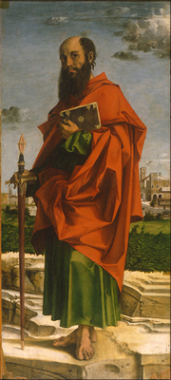
Christianity Ancient Rome
Many passionate believers carried the message of Jesus throughout the Roman Empire. One of the most successful was a Greek-speaking Jew named Saul of Tarsus, known to Christians as Saint Paul. As a young man, Paul helped to persecute Christians, but one day, shortly after the crucifixion of Jesus, Paul had a vision in which he believed Jesus spoke to him from heaven.

Slide 19
Christianity Ancient Rome
Many passionate believers carried the message of Jesus throughout the Roman Empire. One of the most successful was a Greek-speaking Jew named Saul of Tarsus, known to Christians as Saint Paul. As a young man, Paul helped to persecute Christians, but one day, shortly after the crucifixion of Jesus, Paul had a vision in which he believed Jesus spoke to him from heaven.

Slide 20
Christianity Ancient Rome
Many passionate believers carried the message of Jesus throughout the Roman Empire. One of the most successful was a Greek-speaking Jew named Saul of Tarsus, known to Christians as Saint Paul. As a young man, Paul helped to persecute Christians, but one day, shortly after the crucifixion of Jesus, Paul had a vision in which he believed Jesus spoke to him from heaven.

Slide 21
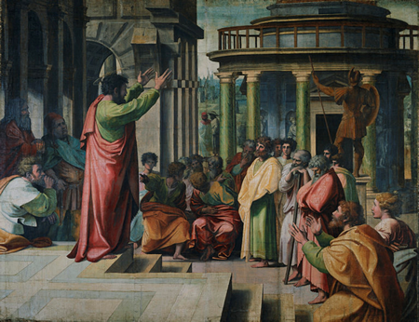
Christianity Ancient Rome
Paul spent the rest of his life writing about Christianity and winning new converts to the faith. Through the persistence of Paul and other Christian missionaries, small Christian communities developed throughout the Roman Empire.

Slide 22
Christianity Ancient Rome
Paul spent the rest of his life writing about Christianity and winning new converts to the faith. Through the persistence of Paul and other Christian missionaries, small Christian communities developed throughout the Roman Empire.

Slide 23
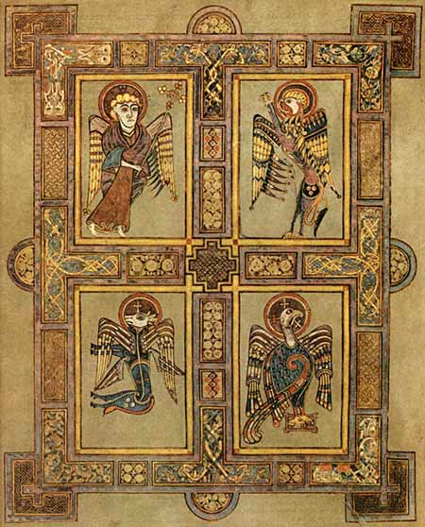
Christianity Ancient Rome
The first Christians believed that Jesus would quickly return to earth, and so saw no need to create any written records of his life. About fifty years after the crucifixion of Jesus, Christians combined the stories of the life and wisdom of Jesus into four books known as Gospels. Gospel means “good news.”

Slide 24
Christianity Ancient Rome
The first Christians believed that Jesus would quickly return to earth, and so saw no need to create any written records of his life. About fifty years after the crucifixion of Jesus, Christians combined the stories of the life and wisdom of Jesus into four books known as Gospels. Gospel means “good news.”

Slide 25
Christianity Ancient Rome
The first Christians believed that Jesus would quickly return to earth, and so saw no need to create any written records of his life. About fifty years after the crucifixion of Jesus, Christians combined the stories of the life and wisdom of Jesus into four books known as Gospels. Gospel means “good news.”

Slide 26
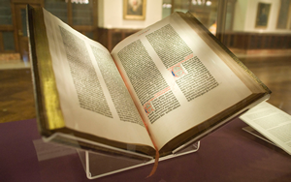
Christianity Ancient Rome
The Bible is the holy book of Christianity; it consists of the Old Testament and the New Testament. The Old Testament was written long before the time of Jesus; it contains the sacred writings of the Jewish people. The New Testament includes the Gospels, along with letters written by Paul and other Christian writers. The Bible has been translated into more than 1,500 languages and has been read by more people than any other book.

Slide 27
Christianity Ancient Rome
The Bible is the holy book of Christianity; it consists of the Old Testament and the New Testament. The Old Testament was written long before the time of Jesus; it contains the sacred writings of the Jewish people. The New Testament includes the Gospels, along with letters written by Paul and other Christian writers. The Bible has been translated into more than 1,500 languages and has been read by more people than any other book.

Slide 28
Christianity Ancient Rome
The Bible is the holy book of Christianity; it consists of the Old Testament and the New Testament. The Old Testament was written long before the time of Jesus; it contains the sacred writings of the Jewish people. The New Testament includes the Gospels, along with letters written by Paul and other Christian writers. The Bible has been translated into more than 1,500 languages and has been read by more people than any other book.

Slide 29
Christianity Ancient Rome
The Bible is the holy book of Christianity; it consists of the Old Testament and the New Testament. The Old Testament was written long before the time of Jesus; it contains the sacred writings of the Jewish people. The New Testament includes the Gospels, along with letters written by Paul and other Christian writers. The Bible has been translated into more than 1,500 languages and has been read by more people than any other book.

Slide 30
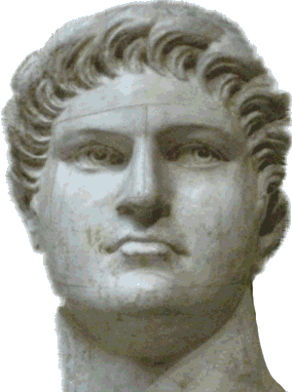
Christianity Ancient Rome
At first, the Romans did not mind that Christians did not worship Roman gods. The Roman Empire was prosperous, and there were not many Christians. The Emperor Nero began persecuting Christians in AD64. Nero blamed Christians for causing a great fire that burned for more than five days and destroyed much of Rome.

Slide 31
Christianity Ancient Rome
At first, the Romans did not mind that Christians did not worship Roman gods. The Roman Empire was prosperous, and there were not many Christians. The Emperor Nero began persecuting Christians in AD64. Nero blamed Christians for causing a great fire that burned for more than five days and destroyed much of Rome.

Slide 32
Christianity Ancient Rome
At first, the Romans did not mind that Christians did not worship Roman gods. The Roman Empire was prosperous, and there were not many Christians. The Emperor Nero began persecuting Christians in AD64. Nero blamed Christians for causing a great fire that burned for more than five days and destroyed much of Rome.

Slide 33
Christianity Ancient Rome
At first, the Romans did not mind that Christians did not worship Roman gods. The Roman Empire was prosperous, and there were not many Christians. The Emperor Nero began persecuting Christians in AD64. Nero blamed Christians for causing a great fire that burned for more than five days and destroyed much of Rome.

Slide 34
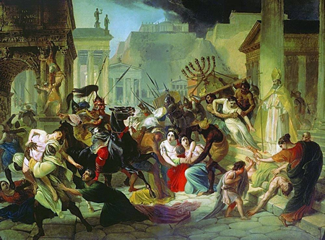
Christianity Ancient Rome
Within the next two hundred years, barbarian warriors attacked the empire. Many Romans suggested that the Roman Empire was experiencing bad times because a growing group of Christians did not worship the Roman gods.

Slide 35
Christianity Ancient Rome
Within the next two hundred years, barbarian warriors attacked the empire. Many Romans suggested that the Roman Empire was experiencing bad times because a growing group of Christians did not worship the Roman gods.

Slide 36
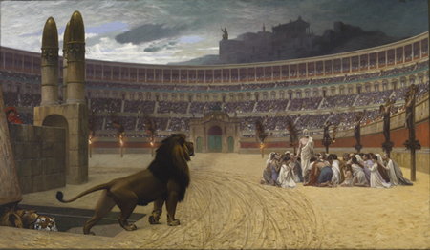
Christianity Ancient Rome
Roman emperors became increasingly intolerant of Christianity. In AD202, Emperor Septimius Severus banned any Roman citizen from converting to Christianity or Judaism. Those who disobeyed the emperor were often tortured by soldiers or forced to fight wild animals at sporting events. Despite the persecutions, Christianity continued to grow.

Slide 37
Christianity Ancient Rome
Roman emperors became increasingly intolerant of Christianity. In AD202, Emperor Septimius Severus banned any Roman citizen from converting to Christianity or Judaism. Those who disobeyed the emperor were often tortured by soldiers or forced to fight wild animals at sporting events. Despite the persecutions, Christianity continued to grow.

Slide 38
Christianity Ancient Rome
Roman emperors became increasingly intolerant of Christianity. In AD202, Emperor Septimius Severus banned any Roman citizen from converting to Christianity or Judaism. Those who disobeyed the emperor were often tortured by soldiers or forced to fight wild animals at sporting events. Despite the persecutions, Christianity continued to grow.

Slide 39
Christianity Ancient Rome
Roman emperors became increasingly intolerant of Christianity. In AD202, Emperor Septimius Severus banned any Roman citizen from converting to Christianity or Judaism. Those who disobeyed the emperor were often tortured by soldiers or forced to fight wild animals at sporting events. Despite the persecutions, Christianity continued to grow.

Slide 40
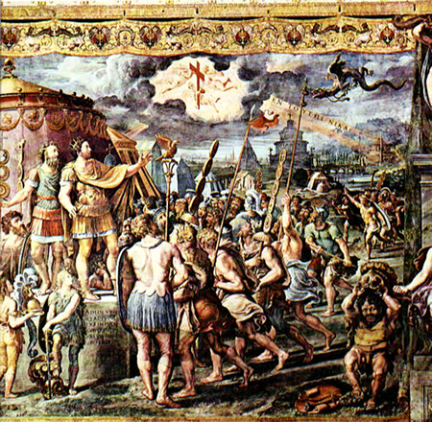
Christianity Ancient Rome
Emperor Constantine ended persecution of Christians when he seized power in AD306. Four years later, Constantine made Christianity legal throughout the Roman Empire. A legend says that on the eve of a battle, Constantine saw a Christian symbol in the sky with words that translate to “By this sign you shall conquer.” Constantine never went so far as to establish Christianity as the official religion of the empire, but he did legalize the religion and encouraged its growth.

Slide 41
Christianity Ancient Rome
Emperor Constantine ended persecution of Christians when he seized power in AD306. Four years later, Constantine made Christianity legal throughout the Roman Empire. A legend says that on the eve of a battle, Constantine saw a Christian symbol in the sky with words that translate to “By this sign you shall conquer.” Constantine never went so far as to establish Christianity as the official religion of the empire, but he did legalize the religion and encouraged its growth.

Slide 42
Christianity Ancient Rome
Emperor Constantine ended persecution of Christians when he seized power in AD306. Four years later, Constantine made Christianity legal throughout the Roman Empire. A legend says that on the eve of a battle, Constantine saw a Christian symbol in the sky with words that translate to “By this sign you shall conquer.” Constantine never went so far as to establish Christianity as the official religion of the empire, but he did legalize the religion and encouraged its growth.

Slide 43
Christianity Ancient Rome
Emperor Constantine ended persecution of Christians when he seized power in AD306. Four years later, Constantine made Christianity legal throughout the Roman Empire. A legend says that on the eve of a battle, Constantine saw a Christian symbol in the sky with words that translate to “By this sign you shall conquer.” Constantine never went so far as to establish Christianity as the official religion of the empire, but he did legalize the religion and encouraged its growth.

Slide 44
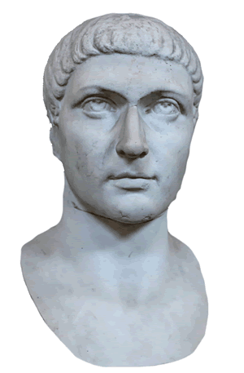
Christianity Ancient Rome
While Constantine supported the Christian Church, he continued to worship Roman gods. In AD337, Constantine was dying. Only then did the emperor call for a bishop so that he could be baptized into the Christian Church. Fifty years after Constantine’s death, Christianity became the official religion of the Roman Empire.

Slide 45
Christianity Ancient Rome
While Constantine supported the Christian Church, he continued to worship Roman gods. In AD337, Constantine was dying. Only then did the emperor call for a bishop so that he could be baptized into the Christian Church. Fifty years after Constantine’s death, Christianity became the official religion of the Roman Empire.

Slide 46
Christianity Ancient Rome
While Constantine supported the Christian Church, he continued to worship Roman gods. In AD337, Constantine was dying. Only then did the emperor call for a bishop so that he could be baptized into the Christian Church. Fifty years after Constantine’s death, Christianity became the official religion of the Roman Empire.

Slide 47
Christianity Ancient Rome
While Constantine supported the Christian Church, he continued to worship Roman gods. In AD337, Constantine was dying. Only then did the emperor call for a bishop so that he could be baptized into the Christian Church. Fifty years after Constantine’s death, Christianity became the official religion of the Roman Empire.

Slide 48
Christianity Ancient Rome
Music credit:
Johann Pachelbel’s “Canon in D Minor” by Kevin MacLeod (incompetech.com)
Licensed under Creative Commons: By Attribution 3.0
http://creativecommons.org/licenses/by/3.0/
Learn more about history at
www.mrdowling.com

