Slide 1
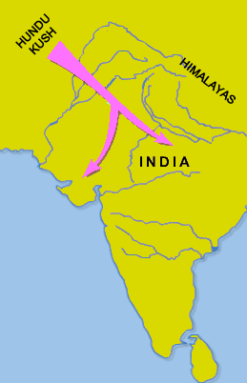
The Aryans Ancient India
The Aryans were warriors that first appeared in northern India about 1500BCE. Most Aryans were nomadic cattle herders, who occasionally practiced slash-and-burn agriculture.

Slide 2
The Aryans Ancient India
The Aryans were warriors that first appeared in northern India about 1500BCE. Most Aryans were nomadic cattle herders, who occasionally practiced slash-and-burn agriculture.

Slide 3
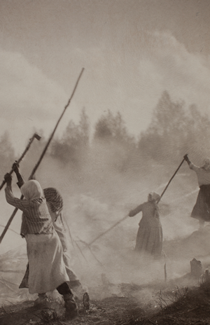
The Aryans Ancient India
A band of Aryans would slash, or cut, the trees on a plot of land to create a field. Months later, when the vegetation had dried, they set it on fire. The ashes left from the fire fertilized the soil for a few growing seasons. The Aryans would repeat the process in a new area once the soil had been exhausted.

Slide 4
The Aryans Ancient India
A band of Aryans would slash, or cut, the trees on a plot of land to create a field. Months later, when the vegetation had dried, they set it on fire. The ashes left from the fire fertilized the soil for a few growing seasons. The Aryans would repeat the process in a new area once the soil had been exhausted.

Slide 5
The Aryans Ancient India
A band of Aryans would slash, or cut, the trees on a plot of land to create a field. Months later, when the vegetation had dried, they set it on fire. The ashes left from the fire fertilized the soil for a few growing seasons. The Aryans would repeat the process in a new area once the soil had been exhausted.

Slide 6
The Aryans Ancient India
A band of Aryans would slash, or cut, the trees on a plot of land to create a field. Months later, when the vegetation had dried, they set it on fire. The ashes left from the fire fertilized the soil for a few growing seasons. The Aryans would repeat the process in a new area once the soil had been exhausted.

Slide 7
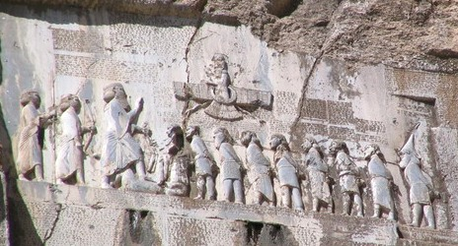
The Aryans Ancient India
The Aryans did not remain in one place for long, so unlike the Indus River Valley culture that preceded them in the region, the Aryans did not build permanent homes.

Slide 8
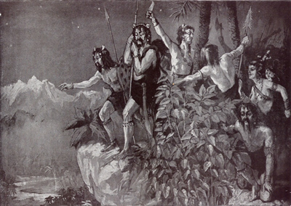
The Aryans Ancient India
The Aryans were skilled warriors. Their experience as cattle herders made them able horsemen. Like the Assyrians of Mesopotamia, the Aryans built chariots with spoke wheels, which were faster and easier to control than chariots with solid wheels. Their military skills allowed bands of Aryans to subjugate the native Dravidian people and to spread their language and culture to most of the subcontinent.

Slide 9
The Aryans Ancient India
The Aryans were skilled warriors. Their experience as cattle herders made them able horsemen. Like the Assyrians of Mesopotamia, the Aryans built chariots with spoke wheels, which were faster and easier to control than chariots with solid wheels. Their military skills allowed bands of Aryans to subjugate the native Dravidian people and to spread their language and culture to most of the subcontinent.

Slide 10
The Aryans Ancient India
The Aryans were skilled warriors. Their experience as cattle herders made them able horsemen. Like the Assyrians of Mesopotamia, the Aryans built chariots with spoke wheels, which were faster and easier to control than chariots with solid wheels. Their military skills allowed bands of Aryans to subjugate the native Dravidian people and to spread their language and culture to most of the subcontinent.

Slide 11
The Aryans Ancient India
The Aryans were skilled warriors. Their experience as cattle herders made them able horsemen. Like the Assyrians of Mesopotamia, the Aryans built chariots with spoke wheels, which were faster and easier to control than chariots with solid wheels. Their military skills allowed bands of Aryans to subjugate the native Dravidian people and to spread their language and culture to most of the subcontinent.

Slide 12
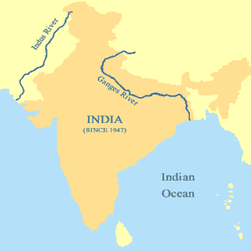
The Aryans Ancient India
About 1000BCE, the Aryans discovered iron ore in the Ganges River Valley. The heavy monsoon rains created dense vegetation in the valley. When the Aryans cleared the trees and brush, they discovered fertile land that allowed them to permanently farm along the banks of the Ganges. Within 500 years, the several villages the Aryans had formed had grown into small states.

Slide 13
The Aryans Ancient India
About 1000BCE, the Aryans discovered iron ore in the Ganges River Valley. The heavy monsoon rains created dense vegetation in the valley. When the Aryans cleared the trees and brush, they discovered fertile land that allowed them to permanently farm along the banks of the Ganges. Within 500 years, the several villages the Aryans had formed had grown into small states.

Slide 14
The Aryans Ancient India
About 1000BCE, the Aryans discovered iron ore in the Ganges River Valley. The heavy monsoon rains created dense vegetation in the valley. When the Aryans cleared the trees and brush, they discovered fertile land that allowed them to permanently farm along the banks of the Ganges. Within 500 years, the several villages the Aryans had formed had grown into small states.

Slide 15
The Aryans Ancient India
About 1000BCE, the Aryans discovered iron ore in the Ganges River Valley. The heavy monsoon rains created dense vegetation in the valley. When the Aryans cleared the trees and brush, they discovered fertile land that allowed them to permanently farm along the banks of the Ganges. Within 500 years, the several villages the Aryans had formed had grown into small states.

Slide 16
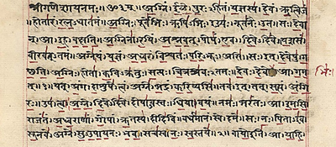
The Aryans Ancient India
The Aryans spoke Sanskrit, a language that is similar to many European languages but unlike the Dravidian languages spoken in India before the Aryan invasion.

Slide 17
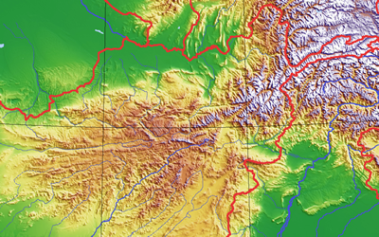
The Aryans Ancient India
The similarities with European languages suggest the Aryans came through the tall mountains of the Hindu Kush from present-day Afghanistan. However, we cannot be sure because there are no stories of a great journey to be found in the songs and poems of the Aryan people.

Slide 18
The Aryans Ancient India
The similarities with European languages suggest the Aryans came through the tall mountains of the Hindu Kush from present-day Afghanistan. However, we cannot be sure because there are no stories of a great journey to be found in the songs and poems of the Aryan people.

Slide 19
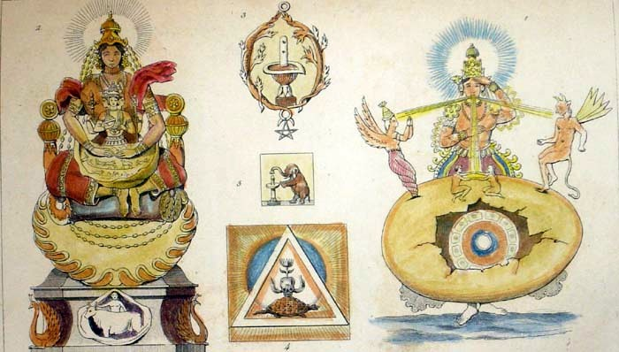
The Aryans Ancient India
The first Aryans on the subcontinent could not read or write, but they did have a rich oral tradition. For hundreds of years, Aryan songs and epic poems were handed down by word of mouth.

Slide 20
The Aryans Ancient India
The first Aryans on the subcontinent could not read or write, but they did have a rich oral tradition. For hundreds of years, Aryan songs and epic poems were handed down by word of mouth.

Slide 21
The Aryans Ancient India
About 500BCE, the Aryans began to compose a body of texts called Vedas based on their traditional stories. Veda is a Sanskrit word that means knowledge. The Rig Veda is a collection of more than 1000 poems that survives to this day. The influence of these stories of the Aryan people on the subcontinent is why historians label the period of Indian history lasting from about 1500BCE to 322BCE as the Vedic Age.

Slide 22
The Aryans Ancient India
About 500BCE, the Aryans began to compose a body of texts called Vedas based on their traditional stories. Veda is a Sanskrit word that means knowledge. The Rig Veda is a collection of more than 1000 poems that survives to this day. The influence of these stories of the Aryan people on the subcontinent is why historians label the period of Indian history lasting from about 1500BCE to 322BCE as the Vedic Age.

Slide 23
The Aryans Ancient India
About 500BCE, the Aryans began to compose a body of texts called Vedas based on their traditional stories. Veda is a Sanskrit word that means knowledge. The Rig Veda is a collection of more than 1000 poems that survives to this day. The influence of these stories of the Aryan people on the subcontinent is why historians label the period of Indian history lasting from about 1500BCE to 322BCE as the Vedic Age.

Slide 24
The Aryans Ancient India
About 500BCE, the Aryans began to compose a body of texts called Vedas based on their traditional stories. Veda is a Sanskrit word that means knowledge. The Rig Veda is a collection of more than 1000 poems that survives to this day. The influence of these stories of the Aryan people on the subcontinent is why historians label the period of Indian history lasting from about 1500BCE to 322BCE as the Vedic Age.

Slide 25
The Aryans Ancient India
Music credit:
Double Drift by Kevin McLeod at incompetech.com
Licensed under Creative Commons: By Attribution 3.0
http://creativecommons.org/licenses/by/3.0/
Learn more about history at
www.mrdowling.com

