Slide 1
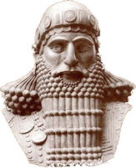
The Code of Hammurabi Mesopotamia
Hammurabi was a Mesopotamian king who recorded a system of laws called the Code of Hammurabi. He ordered 282 laws engraved in stone and placed in a public location for everyone to see.

Slide 2
The Code of Hammurabi Mesopotamia
Hammurabi was a Mesopotamian king who recorded a system of laws called the Code of Hammurabi. He ordered 282 laws engraved in stone and placed in a public location for everyone to see.

Slide 3
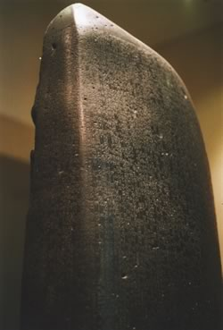
The Code of Hammurabi Mesopotamia
Hammurabi's Code prescribed specific punishments for citizens who broke the law. One law said, "If a man put out the eye of another man, his eye shall be put out.” Later historians summarized Hammurabi's Code with the phrase, "An eye for an eye, a tooth for a tooth.” This means that whoever commits an injury should be punished in the same manner as that injury.

Slide 4
The Code of Hammurabi Mesopotamia
Hammurabi's Code prescribed specific punishments for citizens who broke the law. One law said, "If a man put out the eye of another man, his eye shall be put out." Later historians summarized Hammurabi's Code with the phrase, "An eye for an eye, a tooth for a tooth.” This means that whoever commits an injury should be punished in the same manner as that injury.

Slide 5
The Code of Hammurabi Mesopotamia
Hammurabi's Code prescribed specific punishments for citizens who broke the law. One law said, "If a man put out the eye of another man, his eye shall be put out." Later historians summarized Hammurabi's Code with the phrase, "An eye for an eye, a tooth for a tooth.” This means that whoever commits an injury should be punished in the same manner as that injury.

Slide 6
The Code of Hammurabi Mesopotamia
Hammurabi's Code prescribed specific punishments for citizens who broke the law. One law said, "If a man put out the eye of another man, his eye shall be put out." Later historians summarized Hammurabi's Code with the phrase, "An eye for an eye, a tooth for a tooth.” This means that whoever commits an injury should be punished in the same manner as that injury.

Slide 7
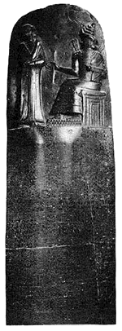
The Code of Hammurabi Mesopotamia
Hammurabi’s code included what we today call both criminal and civil law. Criminal law consists of rules that define conduct. One law said, “if a son strikes his father, his hands shall be hewn off.” Civil law settles disputes among individuals. Hammurabi’s Code states, “if a man builds a house badly, and it falls and kills the owner, the builder is to be killed. If the owner’s son was killed, then the builder’s son is to be killed.”

Slide 8
The Code of Hammurabi Mesopotamia
Hammurabi’s code included what we today call both criminal and civil law. Criminal law consists of rules that define conduct. One law said, “if a son strikes his father, his hands shall be hewn off.” Civil law settles disputes among individuals. Hammurabi’s Code states, “if a man builds a house badly, and it falls and kills the owner, the builder is to be killed. If the owner’s son was killed, then the builder’s son is to be killed.”

Slide 9
The Code of Hammurabi Mesopotamia
Hammurabi’s code included what we today call both criminal and civil law. Criminal law consists of rules that define conduct. One law said, “if a son strikes his father, his hands shall be hewn off.” Civil law settles disputes among individuals. Hammurabi’s Code states, “if a man builds a house badly, and it falls and kills the owner, the builder is to be killed. If the owner’s son was killed, then the builder’s son is to be killed.”

Slide 10
The Code of Hammurabi Mesopotamia
Hammurabi’s code included what we today call both criminal and civil law. Criminal law consists of rules that define conduct. One law said, “if a son strikes his father, his hands shall be hewn off.” Civil law settles disputes among individuals. Hammurabi’s Code states, “if a man builds a house badly, and it falls and kills the owner, the builder is to be killed. If the owner’s son was killed, then the builder’s son is to be killed.”

Slide 11
The Code of Hammurabi Mesopotamia
Hammurabi’s code included what we today call both criminal and civil law. Criminal law consists of rules that define conduct. One law said, “if a son strikes his father, his hands shall be hewn off.” Civil law settles disputes among individuals. Hammurabi’s Code states, “if a man builds a house badly, and it falls and kills the owner, the builder is to be killed. If the owner’s son was killed, then the builder’s son is to be killed.”

Slide 12
The Code of Hammurabi Mesopotamia
Hammurabi’s code included what we today call both criminal and civil law. Criminal law consists of rules that define conduct. One law said, “if a son strikes his father, his hands shall be hewn off.” Civil law settles disputes among individuals. Hammurabi’s Code states, “if a man builds a house badly, and it falls and kills the owner, the builder is to be killed. If the owner’s son was killed, then the builder’s son is to be killed.”

Slide 13
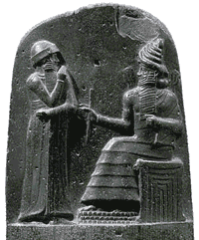
The Code of Hammurabi Mesopotamia
One exception existed to the principle of “an eye for an eye.” It demonstrated that Hammurabi believed the gods had power over people and events. An accused person could jump into the Euphrates River. “If he sinks in the river, his accuser shall take possession of his house. But if the river proves that the accused is not guilty and he escapes unhurt, then he who had brought the accusation shall be put to death, while he who leaped into the river shall take possession of the house that had belonged to hisaccuser.” We can surmise from this law that not many people at that time were able to swim.

Slide 14
The Code of Hammurabi Mesopotamia
One exception existed to the principle of “an eye for an eye.” It demonstrated that Hammurabi believed the gods had power over people and events. An accused person could jump into the Euphrates River. “If he sinks in the river, his accuser shall take possession of his house. But if the river proves that the accused is not guilty and he escapes unhurt, then he who has brought the accusation shall be put to death, while he who leaped into the river shall take possession of the house that had belonged to hisaccuser.” We can surmise from this law that not many people at that time were able to swim.

Slide 15
The Code of Hammurabi Mesopotamia
One exception existed to the principle of “an eye for an eye.” It demonstrated that Hammurabi believed the gods had power over people and events. An accused person could jump into the Euphrates River. “If he sinks in the river, his accuser shall take possession of his house. But if the river proves that the accused is not guilty and he escapes unhurt, then he who has brought the accusation shall be put to death, while he who leaped into the river shall take possession of the house that had belonged to hisaccuser.” We can surmise from this law that not many people at that time were able to swim.

Slide 16
The Code of Hammurabi Mesopotamia
One exception existed to the principle of “an eye for an eye.” It demonstrated that Hammurabi believed the gods had power over people and events. An accused person could jump into the Euphrates River. “If he sinks in the river, his accuser shall take possession of his house. But if the river proves that the accused is not guilty and he escapes unhurt, then he who has brought the accusation shall be put to death, while he who leaped into the river shall take possession of the house that had belonged to hisaccuser.” We can surmise from this law that not many people at that time were able to swim.

Slide 17
The Code of Hammurabi Mesopotamia
One exception existed to the principle of “an eye for an eye.” It demonstrated that Hammurabi believed the gods had power over people and events. An accused person could jump into the Euphrates River. “If he sinks in the river, his accuser shall take possession of his house. But if the river proves that the accused is not guilty and he escapes unhurt, then he who has brought the accusation shall be put to death, while he who leaped into the river shall take possession of the house that had belonged to hisaccuser.” We can surmise from this law that not many people at that time were able to swim.

Slide 18
The Code of Hammurabi Mesopotamia
One exception existed to the principle of “an eye for an eye.” It demonstrated that Hammurabi believed the gods had power over people and events. An accused person could jump into the Euphrates River. “If he sinks in the river, his accuser shall take possession of his house. But if the river proves that the accused is not guilty and he escapes unhurt, then he who has brought the accusation shall be put to death, while he who leaped into the river shall take possession of the house that had belonged to hisaccuser.” We can surmise from this law that not many people at that time were able to swim.

Slide 19
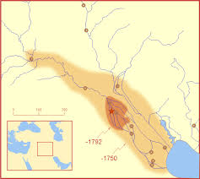
The Code of Hammurabi Mesopotamia
Hammurabi reigned from 1795 to 1750BCE in Babylon. Babylon was one of the many city-states that formed in ancient Mesopotamia. Babylon became famous for its spectacular entertainment. People still refer to a rich city with many luxuries as “a Babylon.”

Slide 20
The Code of Hammurabi Mesopotamia
Hammurabi reigned from 1795 to 1750BCE in Babylon. Babylon was one of the many city-states that formed in ancient Mesopotamia. Babylon became famous for its spectacular entertainment. People still refer to a rich city with many luxuries as “a Babylon.”

Slide 21
The Code of Hammurabi Mesopotamia
Hammurabi reigned from 1795 to 1750BCE in Babylon. Babylon was one of the many city-states that formed in ancient Mesopotamia. Babylon became famous for its spectacular entertainment. People still refer to a rich city with many luxuries as “a Babylon.”

Slide 22
The Code of Hammurabi Mesopotamia
Hammurabi reigned from 1795 to 1750BCE in Babylon. Babylon was one of the many city-states that formed in ancient Mesopotamia. Babylon became famous for its spectacular entertainment. People still refer to a rich city with many luxuries as “a Babylon.”

Slide 23
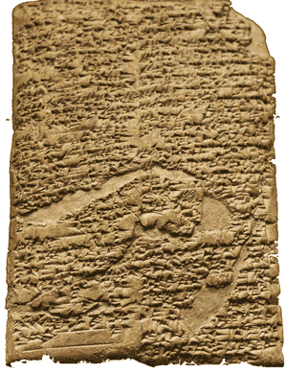
The Code of Hammurabi Mesopotamia
Hammurabi’s Code helps us understand what life was like in ancient Babylon. Equal punishment existed only when both parties were of equal rank. The penalty for injuring a woman or a slave would be less than the penalty for injuring a free man.

Slide 24
The Code of Hammurabi Mesopotamia
Hammurabi’s Code helps us understand what life was like in ancient Babylon. Equal punishment existed only when both parties were of equal rank. The penalty for injuring a woman or a slave would be less than the penalty for injuring a free man.

Slide 25
The Code of Hammurabi Mesopotamia
Hammurabi’s Code helps us understand what life was like in ancient Babylon. Equal punishment existed only when both parties were of equal rank. The penalty for injuring a woman or a slave would be less than the penalty for injuring a free man.

Slide 26
The Code of Hammurabi Mesopotamia
One law said, “if a man strikes a free-born woman so that she loses her unborn child, he shall pay ten shekels for her loss.” Another says, “if a man has caught either a male or female runaway slave in the open field and has brought him back to his owner, the owner of the slave shall give him two shekels of silver.”

Slide 27
The Code of Hammurabi Mesopotamia
One law said, “if a man strikes a free-born woman so that she loses her unborn child, he shall pay ten shekels for her loss.” Another says, “if a man has caught either a male or female runaway slave in the open field and has brought him back to his owner, the owner of the slave shall give him two shekels of silver.”

Slide 28
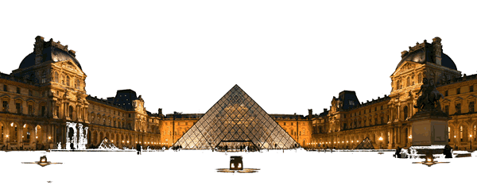
The Code of Hammurabi Mesopotamia
Hammurabi’s Code is the earliest form of law that we are able to read and study because, in 1901, a French expedition to Mesopotamia uncovered a copy of the Babylonian king’s laws. The stone pillar where Hammurabi had his laws engraved is now on display at the Louvre, a museum in Paris, France.

Slide 29
The Code of Hammurabi Mesopotamia
Hammurabi’s Code is the earliest form of law that we are able to read and study because, in 1901, a French expedition to Mesopotamia uncovered a copy of the Babylonian king’s laws. The stone pillar where Hammurabi had his laws engraved is now on display at the Louvre, a museum in Paris, France.

