Slide 1
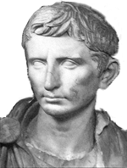
Caesar Augustus Ancient Rome
Octavian was the son of Julius Caesar’s niece. The first eighteen years of Octavian’s life were unremarkable, but a surprise in Julius Caesar’s will eventually resulted in him becoming Caesar Augustus, the ruler who transformed Rome into the greatest empire of the ancient world.

Slide 2
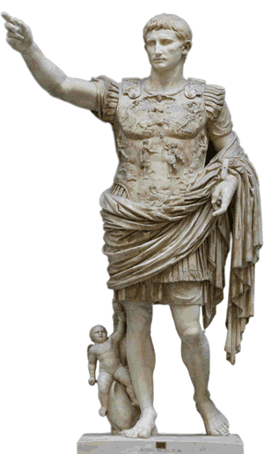
Caesar Augustus Ancient Rome
Octavian was the son of Julius Caesar’s niece. The first eighteen years of Octavian’s life were unremarkable, but a surprise in Julius Caesar’s will eventually resulted in him becoming Caesar Augustus, the ruler who transformed Rome into the greatest empire of the ancient world.

Slide 3
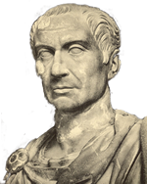
Caesar Augustus Ancient Rome
Julius Caesar was so popular with the Roman people that the Senate named him dictator for life. For five hundred years, the Roman government relied on two consuls serving one-year terms and taking advice from the Senate. But as dictator, Julius Caesar ruled without considering Roman tradition or having to consult the Senate. Finally, in 44BCE, a group of enraged senators stabbed the dictator to death.

Slide 4
Caesar Augustus Ancient Rome
Julius Caesar was so popular with the Roman people that the Senate named him dictator for life. For five hundred years, the Roman government relied on two consuls serving one-year terms and taking advice from the Senate. But as dictator, Julius Caesar ruled without considering Roman tradition or having to consult the Senate. Finally, in 44BCE, a group of enraged senators stabbed the dictator to death.

Slide 5
Caesar Augustus Ancient Rome
Julius Caesar was so popular with the Roman people that the Senate named him dictator for life. For five hundred years, the Roman government relied on two consuls serving one-year terms and taking advice from the Senate. But as dictator, Julius Caesar ruled without considering Roman tradition or having to consult the Senate. Finally, in 44BCE, a group of enraged senators stabbed the dictator to death.

Slide 6
Caesar Augustus Ancient Rome
Julius Caesar was so popular with the Roman people that the Senate named him dictator for life. For five hundred years, the Roman government relied on two consuls serving one-year terms and taking advice from the Senate. But as dictator, Julius Caesar ruled without considering Roman tradition or having to consult the Senate. Finally, in 44BCE, a group of enraged senators stabbed the dictator to death.

Slide 7
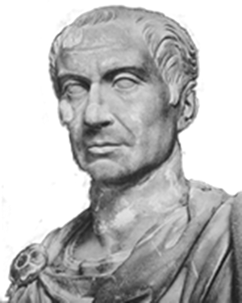
Caesar Augustus Ancient Rome
Caesar’s will decreed that Octavian would be his heir and was to be treated as his adopted son. Caesar’s decision made Octavian one of the
richest men in Rome. It also provided Octavian with something even more valuable: the right to call himself Caesar.

Slide 8
Caesar Augustus Ancient Rome
Caesar’s will decreed that Octavian would be his heir and was to be treated as his adopted son. Caesar’s decision made Octavian one of the
richest men in Rome. It also provided Octavian with something even more valuable: the right to call himself Caesar.

Slide 9
Caesar Augustus Ancient Rome
Caesar’s will decreed that Octavian would be his heir and was to be treated as his adopted son. Caesar’s decision made Octavian one of the
richest men in Rome. It also provided Octavian with something even more valuable: the right to call himself Caesar.

Slide 10
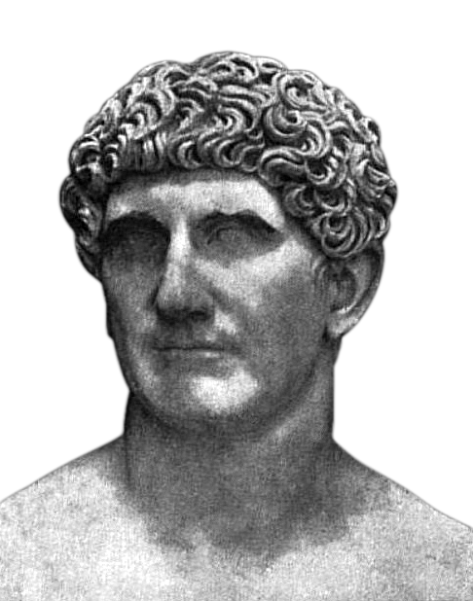
Caesar Augustus Ancient Rome
Two months after Julius Caesar’s murder, Octavian came to Rome to claim his inheritance, but Marc Antony dismissed the young man. Octavian spent the next several months gaining support with the Roman people. He also raised an army. Soldiers throughout the empire were loyal—not to Rome—but to the name Caesar. By the end of 44BCE, both Marc Antony and Octavian commanded armies, but the two men avoided civil war by making a deal.

Slide 11
Caesar Augustus Ancient Rome
Two months after Julius Caesar’s murder, Octavian came to Rome to claim his inheritance, but Marc Antony dismissed the young man. Octavian spent the next several months gaining support with the Roman people. He also raised an army. Soldiers throughout the empire were loyal—not to Rome—but to the name Caesar. By the end of 44BCE, both Marc Antony and Octavian commanded armies, but the two men avoided civil war by making a deal.

Slide 12
Caesar Augustus Ancient Rome
Two months after Julius Caesar’s murder, Octavian came to Rome to claim his inheritance, but Marc Antony dismissed the young man. Octavian spent the next several months gaining support with the Roman people. He also raised an army. Soldiers throughout the empire were loyal—not to Rome—but to the name Caesar. By the end of 44BCE, both Marc Antony and Octavian commanded armies, but the two men avoided civil war by making a deal.

Slide 13
Caesar Augustus Ancient Rome
Two months after Julius Caesar’s murder, Octavian came to Rome to claim his inheritance, but Marc Antony dismissed the young man. Octavian spent the next several months gaining support with the Roman people. He also raised an army. Soldiers throughout the empire were loyal—not to Rome—but to the name Caesar. By the end of 44BCE, both Marc Antony and Octavian commanded armies, but the two men avoided civil war by making a deal.

Slide 14
Caesar Augustus Ancient Rome
Two months after Julius Caesar’s murder, Octavian came to Rome to claim his inheritance, but Marc Antony dismissed the young man. Octavian spent the next several months gaining support with the Roman people. He also raised an army. Soldiers throughout the empire were loyal—not to Rome—but to the name Caesar. By the end of 44BCE, both Marc Antony and Octavian commanded armies, but the two men avoided civil war by making a deal.

Slide 15
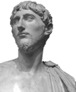
Caesar Augustus Ancient Rome
In 43BCE, Octavian joined Antony and another general named Lepidus in a partnership historians call the Second Triumvirate. The triumvirate raised money by branding more than 300 wealthy Romans as enemies. They seized the property of the newly designated outlaws and offered rewards to anyone who would kill them. The enemies of Octavian and Marc Antony who could not escape from Rome were killed.

Slide 16
Caesar Augustus Ancient Rome
In 43BCE, Octavian joined Antony and another general named Lepidus in a partnership historians call the Second Triumvirate. The triumvirate raised money by branding more than 300 wealthy Romans as enemies. They seized the property of the newly designated outlaws and offered rewards to anyone who would kill them. The enemies of Octavian and Marc Antony who could not escape from Rome were killed.

Slide 17
Caesar Augustus Ancient Rome
In 43BCE, Octavian joined Antony and another general named Lepidus in a partnership historians call the Second Triumvirate. The triumvirate raised money by branding more than 300 wealthy Romans as enemies. They seized the property of the newly designated outlaws and offered rewards to anyone who would kill them. The enemies of Octavian and Marc Antony who could not escape from Rome were killed.

Slide 18
Caesar Augustus Ancient Rome
In 43BCE, Octavian joined Antony and another general named Lepidus in a partnership historians call the Second Triumvirate. The triumvirate raised money by branding more than 300 wealthy Romans as enemies. They seized the property of the newly designated outlaws and offered rewards to anyone who would kill them. The enemies of Octavian and Marc Antony who could not escape from Rome were killed.

Slide 19
Caesar Augustus Ancient Rome
Octavian and Antony forced Lepidus into retirement in 36BCE. Five years later, Octavian became the sole ruler of Rome upon the death of Marc Antony.

Slide 20
Caesar Augustus Ancient Rome
Octavian and Antony forced Lepidus into retirement in 36BCE. Five years later, Octavian became the sole ruler of Rome upon the death of Marc Antony.

Slide 21
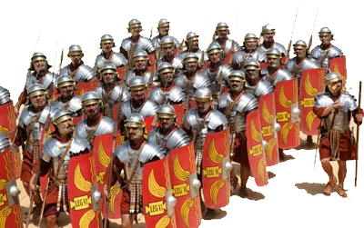
Caesar Augustus Ancient Rome
Octavian earned the loyalty of the Roman soldiers by providing the men with land. The soldiers retired, but because Octavian was Caesar, he knew he could count on their support if the Senate challenged his authority.

Slide 22
Caesar Augustus Ancient Rome
Octavian earned the loyalty of the Roman soldiers by providing the men with land. The soldiers retired, but because Octavian was Caesar, he knew he could count on their support if the Senate challenged his authority.

Slide 23
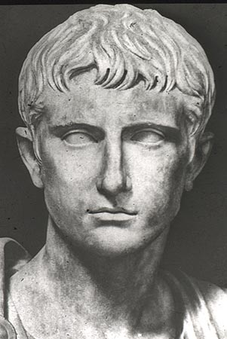
Caesar Augustus Ancient Rome
Octavian lived a modest life to avoid the fate of Julius Caesar. He lived in a small house and traveled without bodyguards. Unlike Julius Caesar, Octavian was respectful to the senators. Later in his career, Octavian allowed other men to serve as consuls, but the Senate knew that Octavian controlled the military, so he was the actual ruler of the Roman Empire.

Slide 24
Caesar Augustus Ancient Rome
Octavian lived a modest life to avoid the fate of Julius Caesar. He lived in a small house and traveled without bodyguards. Unlike Julius Caesar, Octavian was respectful to the senators. Later in his career, Octavian allowed other men to serve as consuls, but the Senate knew that Octavian controlled the military, so he was the actual ruler of the Roman Empire.

Slide 25
Caesar Augustus Ancient Rome
Octavian lived a modest life to avoid the fate of Julius Caesar. He lived in a small house and traveled without bodyguards. Unlike Julius Caesar, Octavian was respectful to the senators. Later in his career, Octavian allowed other men to serve as consuls, but the Senate knew that Octavian controlled the military, so he was the actual ruler of the Roman Empire.

Slide 26
Caesar Augustus Ancient Rome
Octavian lived a modest life to avoid the fate of Julius Caesar. He lived in a small house and traveled without bodyguards. Unlike Julius Caesar, Octavian was respectful to the senators. Later in his career, Octavian allowed other men to serve as consuls, but the Senate knew that Octavian controlled the military, so he was the actual ruler of the Roman Empire.

Slide 27
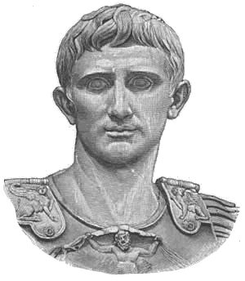
Caesar Augustus Ancient Rome
In 27BCE, Octavian arranged for the Senate to grant him the honorific title Augustus, which means “respected one.” During his rule, the Roman people knew Octavian only as Caesar, but historians, to avoid confusion with his famous granduncle, generally refer him as Octavian before 27BCE and Caesar Augustus after that.

Slide 28
Caesar Augustus Ancient Rome
In 27BCE, Octavian arranged for the Senate to grant him the honorific title Augustus, which means “respected one.” During his rule, the Roman people knew Octavian only as Caesar, but historians, to avoid confusion with his famous granduncle, generally refer him as Octavian before 27BCE and Caesar Augustus after that.

Slide 29
Caesar Augustus Ancient Rome
Caesar Augustus ruled for 41 years, a period that saw Rome develop into a military empire, so historians consider him to be the first Roman Emperor. He restored peace and order to Rome after years of civil war, made sure the lands throughout the empire were well run and that taxes were fair. He built roads and bridges, government buildings and massive public baths. “I left Rome a city of marble,” Caesar said, “though I found it a city of bricks.”

Slide 30
Caesar Augustus Ancient Rome
Caesar Augustus ruled for 41 years, a period that saw Rome develop into a military empire, so historians consider him to be the first Roman Emperor. He restored peace and order to Rome after years of civil war, made sure the lands throughout the empire were well run and that taxes were fair. He built roads and bridges, government buildings and massive public baths. “I left Rome a city of marble,” Caesar said, “though I found it a city of bricks.”

Slide 31
Caesar Augustus Ancient Rome
Caesar Augustus ruled for 41 years, a period that saw Rome develop into a military empire, so historians consider him to be the first Roman Emperor. He restored peace and order to Rome after years of civil war, made sure the lands throughout the empire were well run and that taxes were fair. He built roads and bridges, government buildings and massive public baths. “I left Rome a city of marble,” Caesar said, “though I found it a city of bricks.”

Slide 32
Caesar Augustus Ancient Rome
Caesar Augustus ruled for 41 years, a period that saw Rome develop into a military empire, so historians consider him to be the first Roman Emperor. He restored peace and order to Rome after years of civil war, made sure the lands throughout the empire were well run and that taxes were fair. He built roads and bridges, government buildings and massive public baths. “I left Rome a city of marble,” Caesar said, “though I found it a city of bricks.”

Slide 33
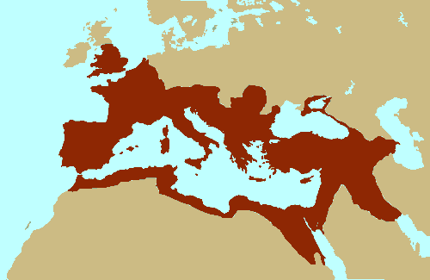
Caesar Augustus Ancient Rome
The armies of Caesar Augustus conquered most of Western Europe, North Africa and the Middle East. The Romans claimed all of the land surrounding the enormous Mediterranean Sea, which they nicknamed “a Roman lake.”

Slide 34
Caesar Augustus Ancient Rome
The armies of Caesar Augustus conquered most of Western Europe, North Africa and the Middle East. The Romans claimed all of the land surrounding the enormous Mediterranean Sea, which they nicknamed “a Roman lake.”

Slide 35
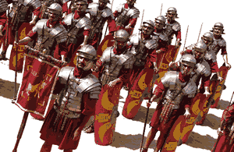
Caesar Augustus Ancient Rome
Rome’s army was so powerful that it protected citizens from attack from the tribes who lived beyond the empire. Historian Edward Gibbon later described the two hundred-years of peace that began with the rule of Caesar Augustus as the Pax Romana, or the “Peace of Rome.”

Slide 36
Caesar Augustus Ancient Rome
Rome’s army was so powerful that it protected citizens from attack from the tribes who lived beyond the empire. Historian Edward Gibbon later described the two hundred-years of peace that began with the rule of Caesar Augustus as the Pax Romana, or the “Peace of Rome.”

Slide 37
Caesar Augustus Ancient Rome
Music credit:
Climb to Elara by Dan O’Connor (DanoSongs.com)
Licensed under Creative Commons: by Attribution 3.0
Learn more about history at
www.mrdowling.com

